Slide 1
Machine Learning HW1
COVID-19 Cases Prediction
ML TAs
ntu-ml-2021spring-ta@googlegroups.com

Slide 2
Outline
Objectives
Task Description
Data
Evaluation Metric
Kaggle
Grading
Code Submission
Deadlines
Hints
Regulations again
Useful Links

Slide 3
Objectives
Solve a regression problem with deep neural networks (DNN).
Understand basic DNN training tips
e.g. hyper-parameter tuning, feature selection, regularization, ...
Get familiar with PyTorch.

Slide 4
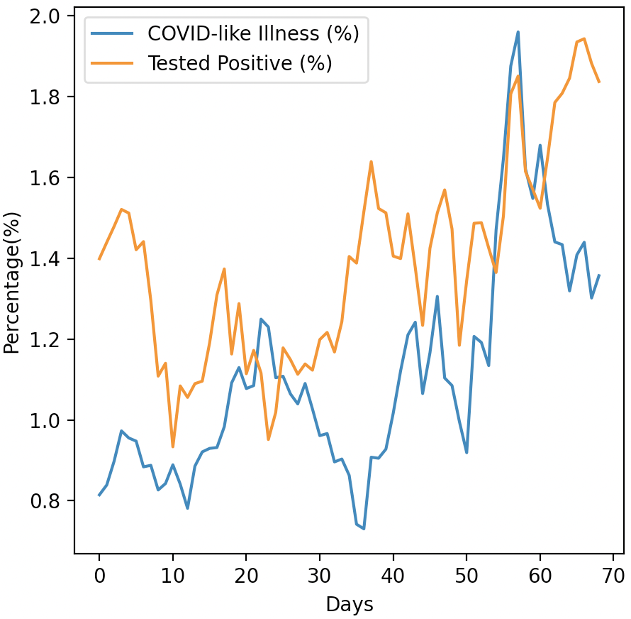
Task Description
COVID-19 Cases Prediction
Source: Delphi group @ CMU
A daily survey since April 2020 via facebook.
Do not attempt to find any related data!
Using additional data is prohibited and your final grade x 0.9 !

Slide 5



Task Description
Given survey results in the past 3 days in a specific state in U.S., then predict the percentage of new tested positive cases in the 3rd day.
survey
positive
cases
survey
positive
cases
survey
positive
cases
Day 1
Day 2
Day 3

Slide 6


Data -- Delphi's COVID-19 Surveys
Conducted surveys via facebook (every day & every state)
Survey: symptoms, COVID-19 testing, social distancing, mental health, demographics, economic effects, ...

Slide 7




Data -- Delphi's COVID-19 Surveys
estimation for all population in that state
(data we are using)
All population in a certain state of the U.S.
some samples
survey

Slide 8
Data -- Delphi's COVID-19 Surveys
States (40, encoded to one-hot vectors)
e.g. AL, AK, AZ, ...
COVID-like illness (4)
e.g. cli,ili (influenza-like illness), ...
Behavior Indicators (8)
e.g. wearing_mask, travel_outside_state, ...
Mental Health Indicators (5)
e.g. anxious, depressed, ...
Tested Positive Cases (1)
tested_positive (this is what we want to predict)
Percentage

Slide 9

Data -- One-hot Vector
One-hot vectors:
Vectors with only one element equals to one while others are zero.
Usually used to encode discrete values.
AL (Alabama)
AK (Alaska)
AZ (Arizona)
AR (Arkansas)
WI (Wisconsin)
one-hot encoding
If state code = AZ
(Arizona)

Slide 10
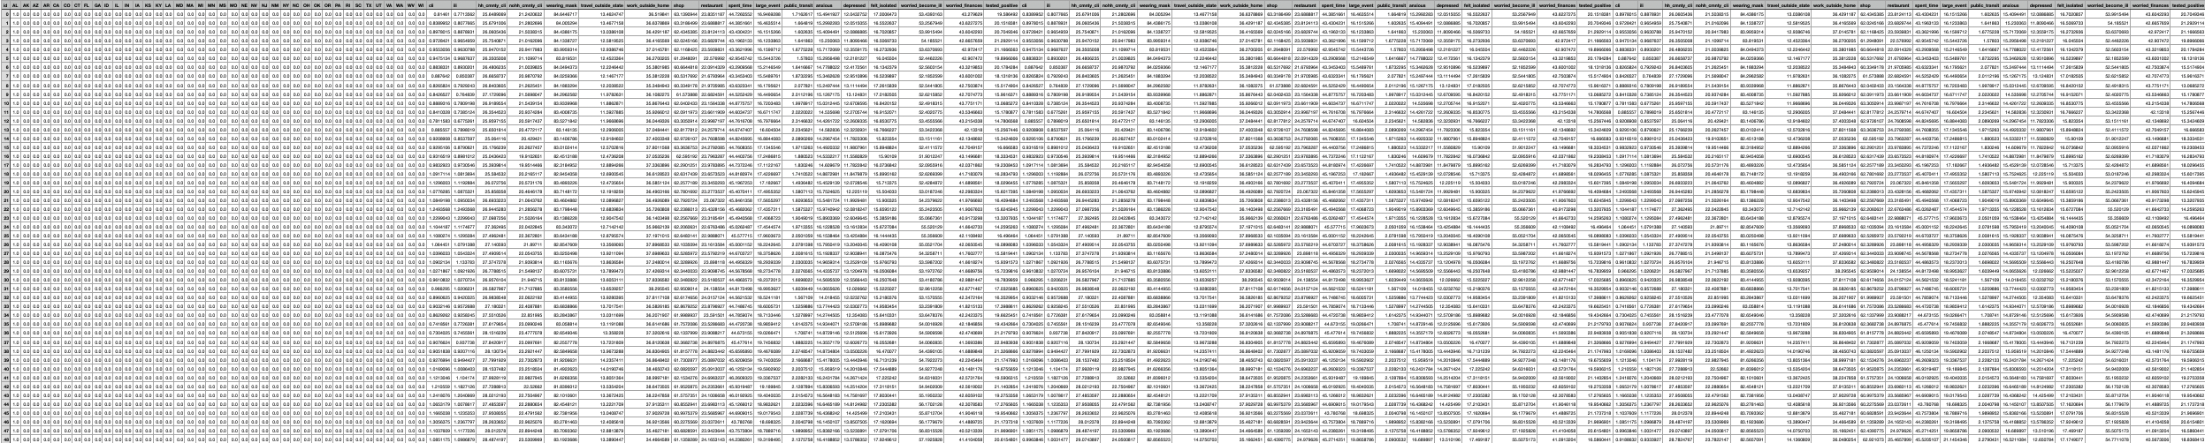
Data -- Training
covid.train.csv (2700 samples)
state one-hot encoding (40)
Day 1 features
(18)
Day 2 features
(18)
Day 3 features
(18)
tested
positive
1 row = 1 sample

Slide 11
Data -- Testing
covid.test.csv (893 samples)
state one-hot encoding (40)
Day 1 features
(18)
Day 2 features
(18)
Day 3 features
(17)
1 row = 1 sample

Slide 12
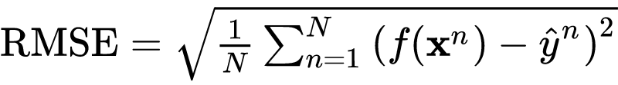
Evaluation Metric
Root Mean Squared Error (RMSE)
your model
ground truth label
(correct answer)
input features
(testing data)

Slide 13
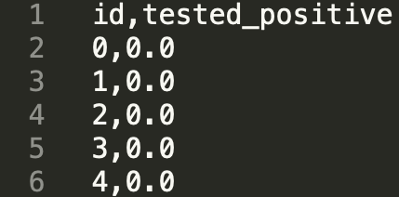
Kaggle
Link: TBA
Displayed name: <student ID>_<anything>
e.g. b06901020_puipui
For auditing, don’t put student ID in your displayed name.
Submission format: .csv file
See sample code

Slide 14
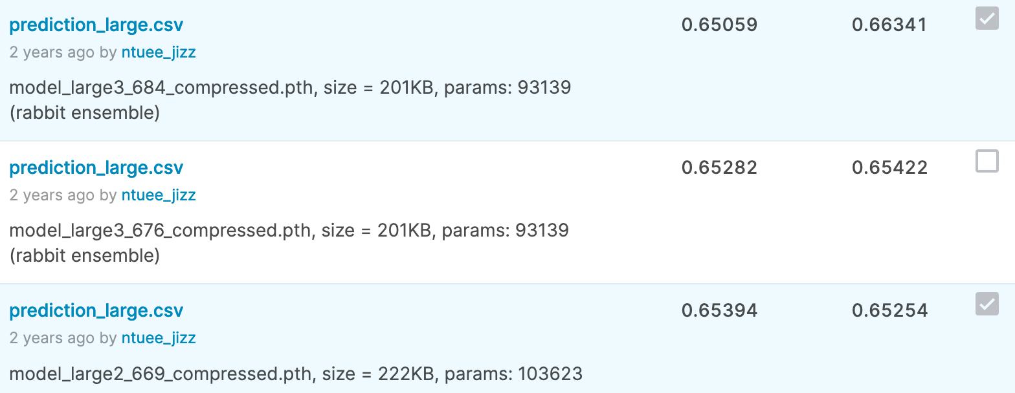
Kaggle -- Submission
You may submit up to 5 results each day (UTC).
Up to 2 submissions will be considered for the private leaderboard.
remember to select 2 results for your final scores before the competition ends!

Slide 15
Grading
Simple baseline (public) +1 pt (sample code)
Simple baseline (private) +1 pt (sample code)
Medium baseline (public) +1 pt
Medium baseline (private) +1 pt
Strong baseline (public) +1 pt
Strong baseline (private) +1 pt
Upload code to NTU COOL +4 pts
Total: 10 pts

Slide 16
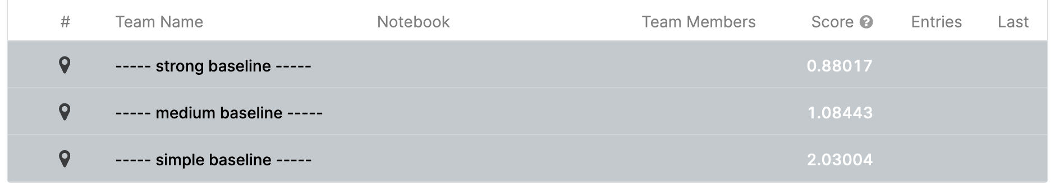
Grading -- Kaggle
The baselines might be modified.

Slide 17
Grading -- Bonus
If you got 10 points, we make your code public to the whole class.
In this case, if you also submit a PDF report briefly describing your methods (<100 words in English), you get a bonus of 0.5 pt.
(your report will also be available to all students)
Report template

Slide 18
Code Submission
NTU COOL (4pts)
Compress your code and report into
<student ID>_hw1_v<version>.zip
e.g. b06901020_hw1_v1.zip (versions: 1, 2, 3, ...)
Do not submit your model or dataset.
If your code is not reasonable, your semester grade x 0.9.

Slide 19
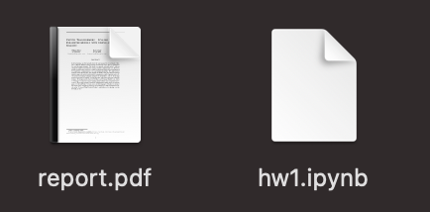
Code Submission
Your .zip file should include only
Code: either .py or .ipynb
Report: .pdf (only for those who passed all baselines)
Example:

Slide 20
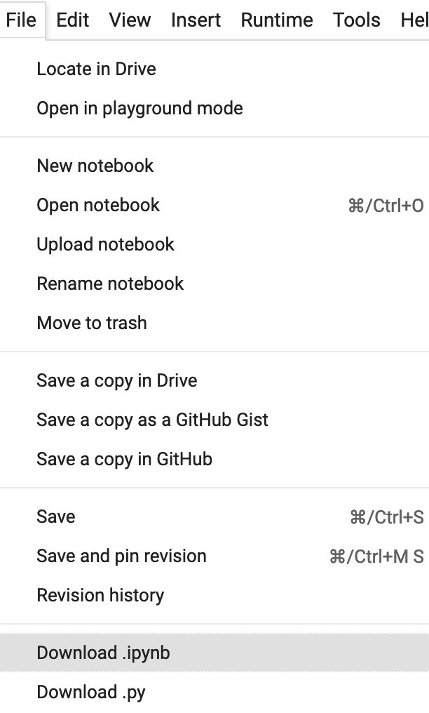
Code Submission
How to download your code from Google Colab?

Slide 21
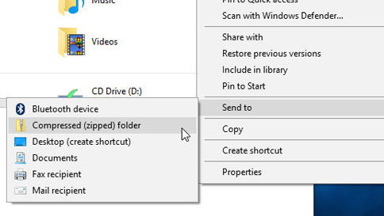
Code Submission
How to compress your folder?
Method 1 (for Windows users)
https://support.microsoft.com/en-us/windows/zip-and-unzip-files-f6dde0a7-0fec-8294-e1d3-703ed85e7ebc
1
2

Slide 22
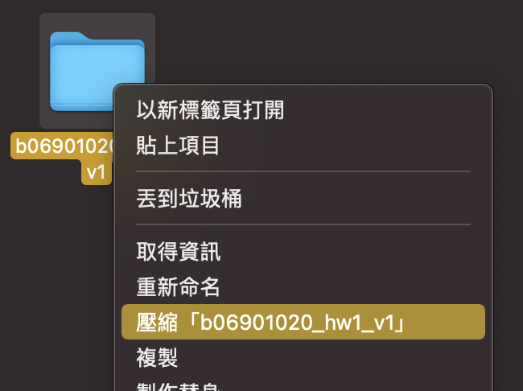
Code Submission
How to compress your folder?
Method 2 (for Mac users)
https://support.apple.com/guide/mac-help/mchlp2528/mac
Compress “b06901020_hw1_v1”

Slide 23
Code Submission
How to compress your folder?
Method 3 (command line)
zip -r <name>.zip <directory name>
e.g.
zip -r b06901020_hw1_v1.zip b06901020_hw1_v1

Slide 24
Deadlines
Kaggle
2021/03/26 23:59 (UTC+8)
Code Submission (NTU COOL)
2021/03/28 23:59 (UTC+8)
No late submission!
Submit early!

Slide 25
Hints
Simple Baseline
Sample code (TBA)
Medium Baseline
Feature selection: 40 states + 2 tested_positive
(will be demonstrated in class)
Strong Baseline
Feature selection (what other features are useful?)
DNN architecture (layers? dimension? activation function?)
Training (mini-batch? optimizer? learning rate?)
L2 regularization
There are some mistakes in the sample code, can you find them?

Slide 26
Regulations Again
You should finish your homework on your own.
You should NOT modify your prediction files manually.
Do NOT share codes or prediction files with any living creatures.
Do NOT use any approaches to submit your results more than 5 times a day.
Do NOT search or use additional data or pre-trained models.
Your final grade x 0.9 if you violate any of the above rules.
Prof. Lee & TAs preserve the rights to change the rules & grades.

Slide 27
If any questions, you can ask us via...
NTU COOL (recommended)
https://cool.ntu.edu.tw/courses/4793
Email
ntu-ml-2021spring-ta@googlegroups.com
Title should begin with “[hw1]”
TA hour
Each Friday during class

Slide 28
Useful Links
Hung-yi Lee, Regression & Gradient Descent (Mandarin)
(link1, link2, link3, link4, link5, link6)
Hung-yi Lee, Tips for Training Deep Networks (Mandarin)
(link1, link2)
Google Machine Learning Crash Course (English)
(Regularization, NN Training)
https://pytorch.org/docs/stable/index.html
https://www.google.com/
(If Google or Stackoverflow can solve your problems, you may take advantage of them before asking TAs.)

Slide 29
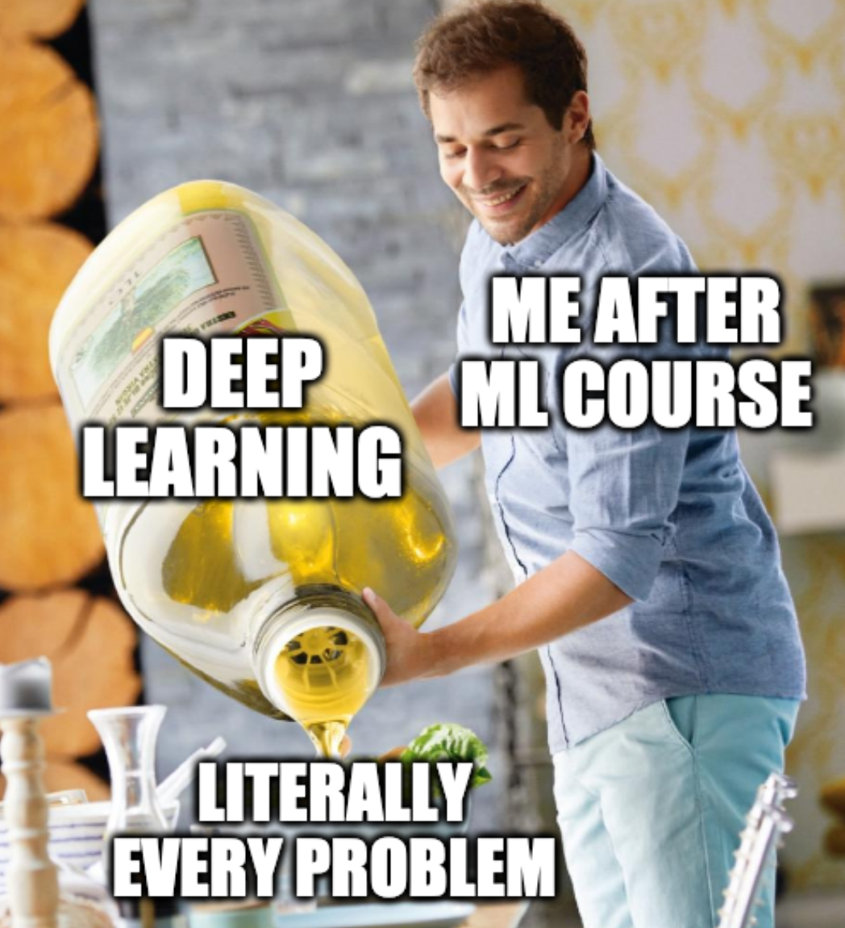
Have fun and wish you good luck!

